Slide 1
Batch processing
Batch processing is the automated processing of large amounts of data without human intervention. It is an efficient way to process data that is too large or complex to be processed in real time.

Slide 2
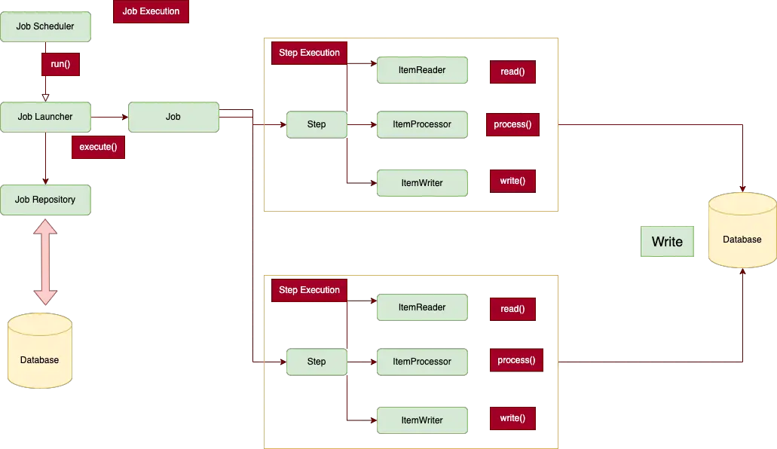

Slide 3
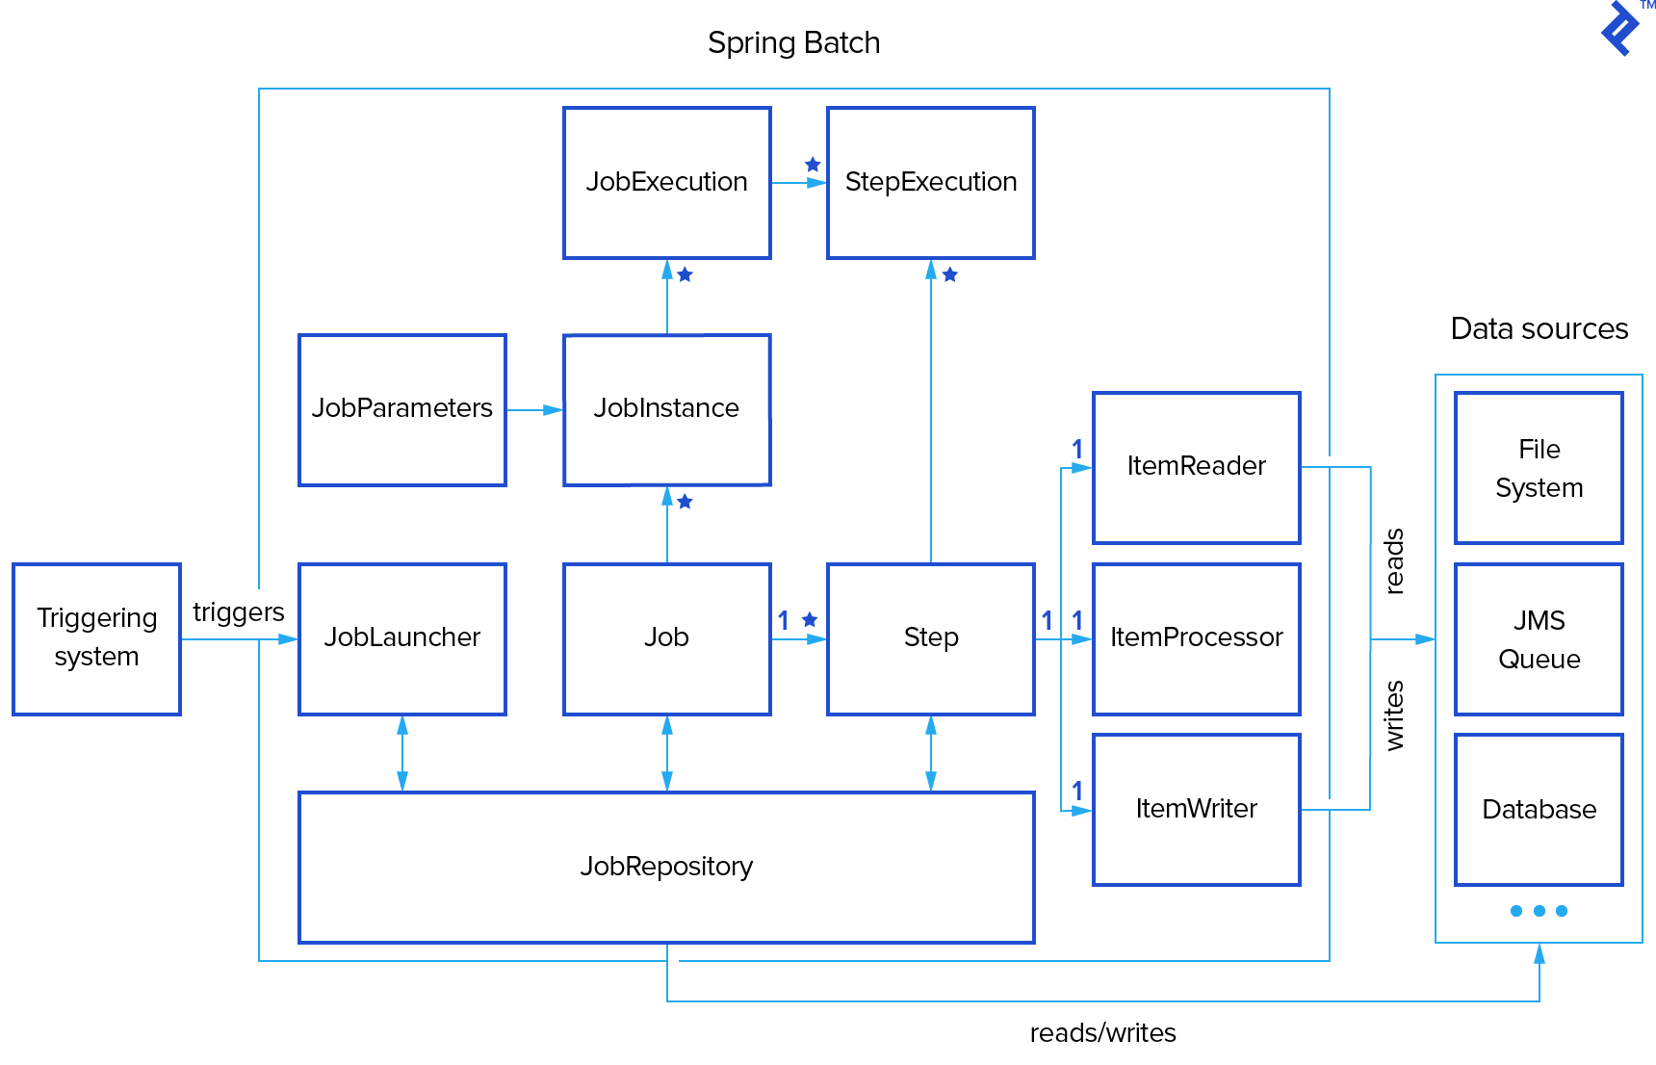

Slide 4
What Is Spring Batch
A batch job is a computer program or set of programs processed in batch mode. This means that a sequence of commands to be executed by the operating system is listed in a file (often called a batch file, command file, or shell script) and submitted for execution as a single unit.
A batch job reads input data, processes the input data, and writes the processed data to
the configured output.

Slide 5
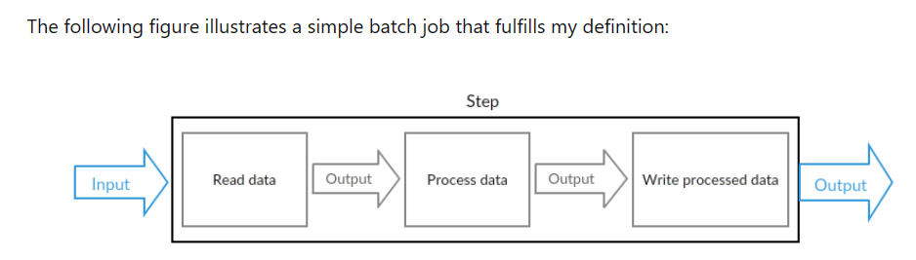

Slide 6
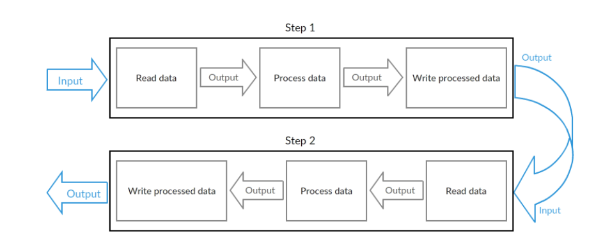
A batch job consists of one or more steps. Each step is responsible of completing one logical task. Every step reads input data, processes the input data, and writes the processed data to the configured output. If the batch job has more than one step, the output of a step is often used as an input of the next step.

Slide 7
What is Job launcher in Spring Batch framework
JobLauncher represents a simple interface for launching a Job with a given set of JobParameters.
The JobLauncher interface has a single method called run(), which is used to launch a specific job along with its parameters.
Job Launcher
The entire job starts execution using a Job Launcher, which may pass job parameters to the job. Many enterprises prefer to launch jobs using a scheduler.

Slide 8
Job
A job represents the entire batch process that we want to execute. It can have one or more steps that execute in a flow. In the small use cases, generally one job has one step, but when multiple sources/destinations are involved, it can have multiple steps. The flow from one step to another can be dynamic, such as it can be conditional or occur in parallel. For example, transferring data from a source to a destination with or without the transformation of data is an example of the Job.

Slide 9
The Job Instance
A Job Launcher is used in order to execute a Spring Batch Job. Note the following points about a Job thus created:
Each execution of a Job is called a Job Instance. Each Job Instance is provided with a unique execution id, which is useful to restart the job if it fails.
A Job can be configured with parameters. These can be passed to it from the Job Launcher.
A job instance consists of a job and job parameters. We define this contract with the following equation: JobInstance = Job + JobParameters.
JobInstance can be restarted multiple times in case of execution failure, and its lifecycle ends with first successful execution.
Trying to execute an existing JobInstance that has already completed successfully results in an error.
An error is also raised for an attempt to restart a failed JobInstance if the Job is not restartable.

Slide 10
Step
A step is a phase in a job that defines how the actual processing will occur for that portion of the job. There are two types of steps:
Tasklet-based
Chunk-based Step.

Slide 11
Tasklet-based Step
In Spring Batch, a Tasklet is an interface that performs a single task within a Step. A typical use case for implementing a Tasklet is the setup up or cleaning of resources before or after the execution of a Step.
Spring Batch Tasklet Example · CodeNotFound

Slide 12
Chunk-based Step
It is used in scenarios where we need to process data from a data source. In this case, each step has a reader, writer and an optional processor. It leverages the ItemReader interface to read chunks of data from a data source. Then writes the chunks in a transaction using the ItemWriter interface. Optionally, we can include an ItemProcessor implementation to perform transformations on the data. Generally, we use Chunk-based Step in real time use cases.

Slide 13
ItemReader: It reads data from the source.
ItemWriter: ItemWriter writes the data to the destination.
ItemProcessor: It does calculations, validations, filtering on the data as part of data transformation before writing the data into the destination.

Slide 14
Job Repository
As the job runs, metadata regarding the job is written to the job repository. Typically, the Job Repository stores metadata regarding JobParameters, JobInstances, JobExecutions, and StepExecutions.
JobRepository is the mechanism in Spring Batch that makes all this persistence possible. It provides CRUD operations for JobLauncher, Job, and Step instantiations. Once a Job is launched, a JobExecution is obtained from the repository and, during the course of execution, StepExecution and JobExecution instances are persisted to the repository.

Slide 15
JobInstance
When a job launcher creates a job, it typically will pass the name of the job and some parameters. The combination of job name and its parameters defines a new JobInstance which is created.

Slide 16
JobExecution
Each run of a JobInstance is referred to as a JobExecution.
Each JobExecution typically tracks what happened during a run, such as current and exit statuses, start and end times, etc.

Slide 17
ExecutionContext
The ExecutionContext in Spring Batch is a key-value store that allows you to share data between different components of a job. This can be useful for passing data from one step to another, or for storing data that needs to be accessed by multiple components of a job.
The ExecutionContext is scoped to either a StepExecution or a JobExecution. This means that data stored in the ExecutionContext will only be available to components that are within the same scope. For example, data stored in the StepExecution ExecutionContext will only be available to components that are executing within the same step.
The ExecutionContext is persisted by Spring Batch, which means that it will be available even if a job is restarted. This can be useful for storing data that needs to be used across multiple job executions.

Slide 18
StepExecution
Similar to a Job, a Step has an individual StepExecution that represents a single attempt to execute a Step.
StepExecution stores the information about current and exit statuses, start and end times, and so on,
as well as references to its corresponding Step and JobExecution instances

Slide 19
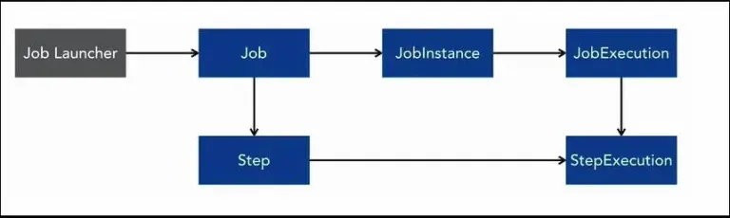
StepExecution
As the steps execute within a job, there is a very similar concept of JobExecution is applied. So, each execution of a step is going to create a new StepExecution. The StepExecution is associated with a JobExecution.

Slide 20
StepExecution
As the steps execute within a job, there is a very similar concept of JobExecution is applied. So, each execution of a step is going to create a new StepExecution. The StepExecution is associated with a JobExecution.

Slide 21
ExecutionContext
An ExecutionContext is a set of key-value pairs containing information that is scoped to either StepExecution or JobExecution. Spring Batch persists the ExecutionContext, which helps in cases where you want to restart a batch run (e.g., when a fatal error has occurred, etc.). All that is needed is to put any object to be shared between steps into the context and the framework will take care of the rest. After restart, the values from the prior ExecutionContext are restored from the database and applied.

Slide 22
Types of itemReader in spring batch
FlatFileItemReader: This reader is used to read data from flat files, such as CSV or fixed-length format files.
JdbcCursorItemReader: This reader fetches data from a database using a JDBC cursor. It's suitable for reading large datasets from a database.
JpaPagingItemReader: This reader reads data from a JPA (Java Persistence API) entity using pagination. It's helpful when you want to read data from a database table using JPA entities.
HibernateCursorItemReader: Similar to JdbcCursorItemReader, this reader uses Hibernate's scrollable cursor to fetch data from a database.
MultiResourceItemReader: This reader allows you to read data from multiple resources, such as multiple files, using a single reader instance.

Slide 23
Types of itemReader in spring batch
StaxEventItemReader: This reader reads data from XML files using the StAX (Streaming API for XML) parser. It's useful for processing large XML files.
JsonItemReader: This reader is used to read data from JSON files using Jackson or other JSON processing libraries.
ItemStreamReader: This is a generic interface that extends the ItemReader interface. It's used when you need to implement a custom reader that supports checkpointing and restarting from the last read item.
CompositeItemReader: This reader allows you to chain multiple ItemReader instances together. It reads items sequentially from each delegate reader.
Custom ItemReader: You can create your own custom implementation of the ItemReader interface to read data from any source that is not covered by the built-in readers.

Slide 24
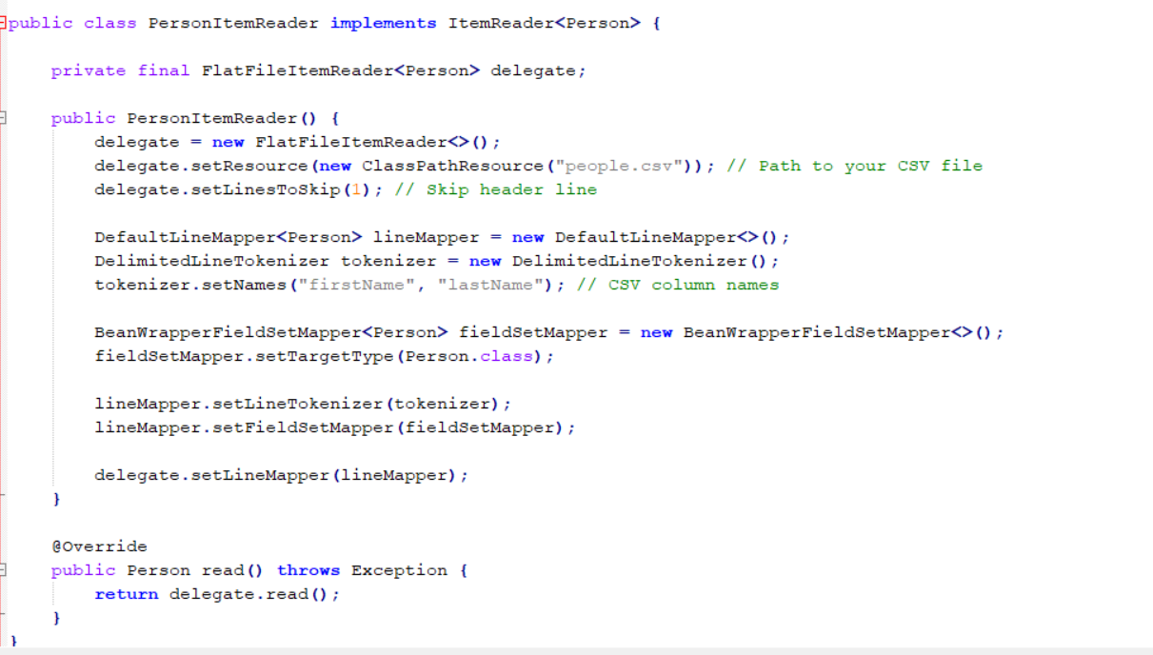
ItemReader

Slide 25
Item Reader
We're using FlatFileItemReader as the delegate reader, which is a common choice for reading data from flat files like CSV.
We're configuring the reader to read from a CSV file named "people.csv" located in the classpath.
The DelimitedLineTokenizer is used to split each line into fields based on a delimiter (usually a comma for CSV files).
BeanWrapperFieldSetMapper maps the fields from the CSV to the fields of the Person object.
DefaultLineMapper ties together the tokenizer and field set mapper.
The read() method of PersonItemReader reads and maps one line at a time.

Slide 26
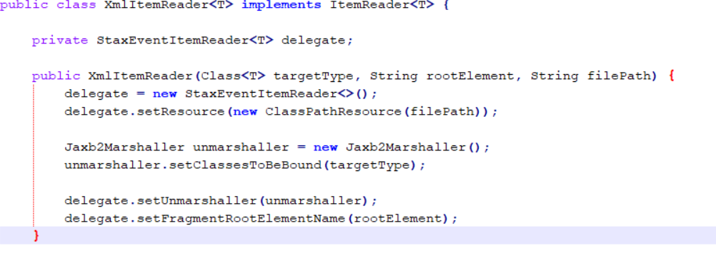
Item Reader

Slide 27
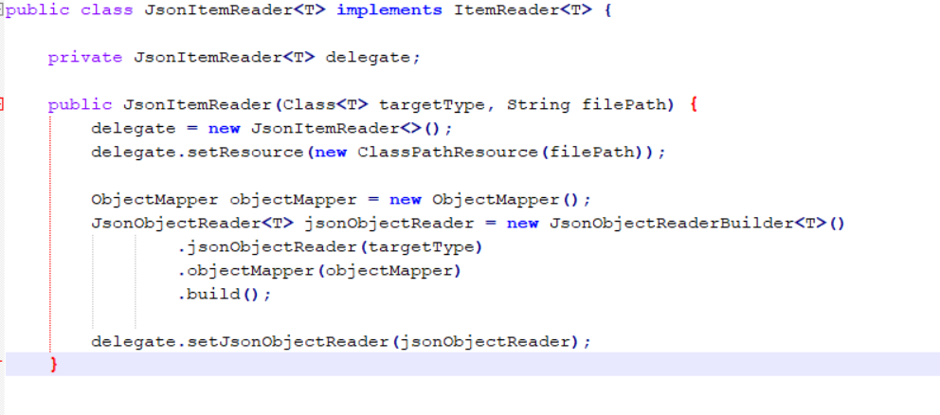
Item Reader

Slide 28
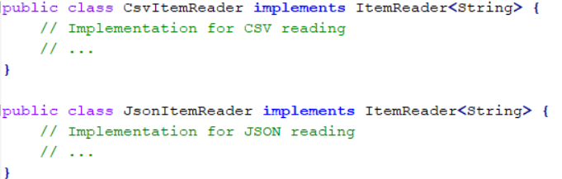
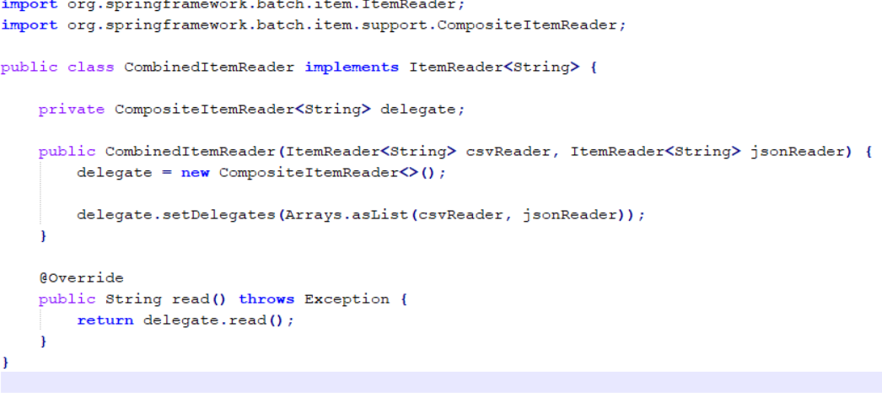
CompositeItemReader

Slide 29
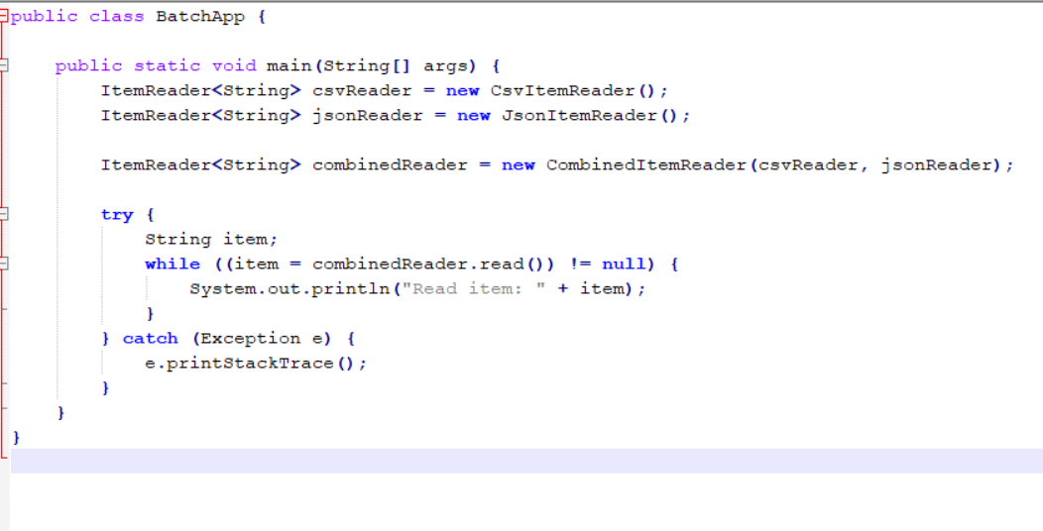
CompositeItemReader contd..

Slide 30
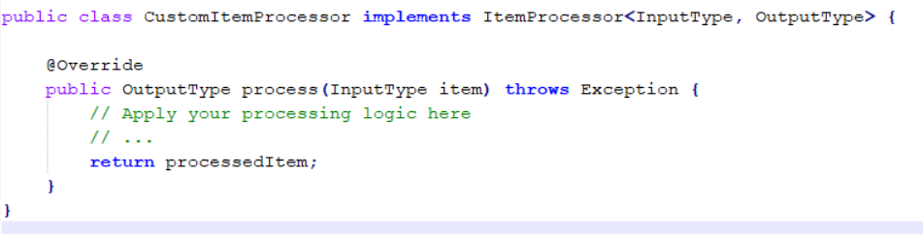
ItemProcessor
An ItemProcessor is a component used to process each item (or record) as it's read by the ItemReader and before it's written by the ItemWriter. It's a way to apply business logic, transformations, validations, or any other necessary operations on the data before it's persisted or further processed. Here's how you can use the ItemProcessor:

Slide 31
Types Of itemProcessor
Data Transformation: transforming data from one format to another.
Data Validation:validating data against specific criteria.
Data Enrichment:Data enrichment involves adding more information to an existing item.
Data Filtering: ItemProcessor can be used to filter out unwanted data items based on specific conditions.
Data Deduplication:You might use an ItemProcessor to identify and remove duplicate data items based on certain fields or attributes.

Slide 32
Types Of itemProcessor
Data Aggregation: In some cases, you might use an ItemProcessor to aggregate data.
Data Cleanup:Data cleanup involves fixing or standardizing data inconsistencies or errors.
Data Encryption or Hashing: You can use an ItemProcessor to apply encryption or hashing algorithms to sensitive data before storing it, ensuring data security.
Complex Calculations:If your batch processing requires complex calculations based on input data, you can implement an ItemProcessor to perform these calculations and provide results to the ItemWriter.
Custom Business Logic: Sometimes, processing requirements might involve specific business logic unique to your application. An ItemProcessor can encapsulate this custom logic.

Slide 33
Types of ItemWriter
JdbcBatchItemWriter:
This writer is used to write data to a relational database using JDBC. It can be configured to execute batch insert, update, or delete operations.
JpaItemWriter:
This writer writes data to a database using JPA (Java Persistence API) entities. It's useful when you want to persist data using JPA's EntityManager.
FlatFileItemWriter:
This writer is used to write data to flat files, such as CSV or fixed-length format files. It writes data line by line.
StaxEventItemWriter:
This writer is used to write data to XML files using the StAX (Streaming API for XML) writer. It's useful for writing large XML files efficiently.
JsonItemWriter:
This writer is used to write data to JSON files using libraries like Jackson. It's used to serialize data into JSON format.

Slide 34
Types of ItemWriter
Custom ItemWriter:
You can create your own custom implementation of the ItemWriter interface to write data to any destination that isn't covered by the built-in writers.
CompositeItemWriter:
This writer allows you to chain multiple ItemWriter instances together. It writes items sequentially to each delegate writer.
ItemStreamWriter:
This is a generic interface that extends the ItemWriter interface. It's used when you need to implement a custom writer that supports checkpointing and restarting from the last written item.
SynchronizedItemStreamWriter:
Similar to ItemStreamWriter, this interface is used when you need a writer to be thread-safe, allowing multiple threads to write concurrently.
MultiResourceItemWriter:
This writer allows you to write data to multiple resources, such as multiple files, using a single writer instance.

Slide 35
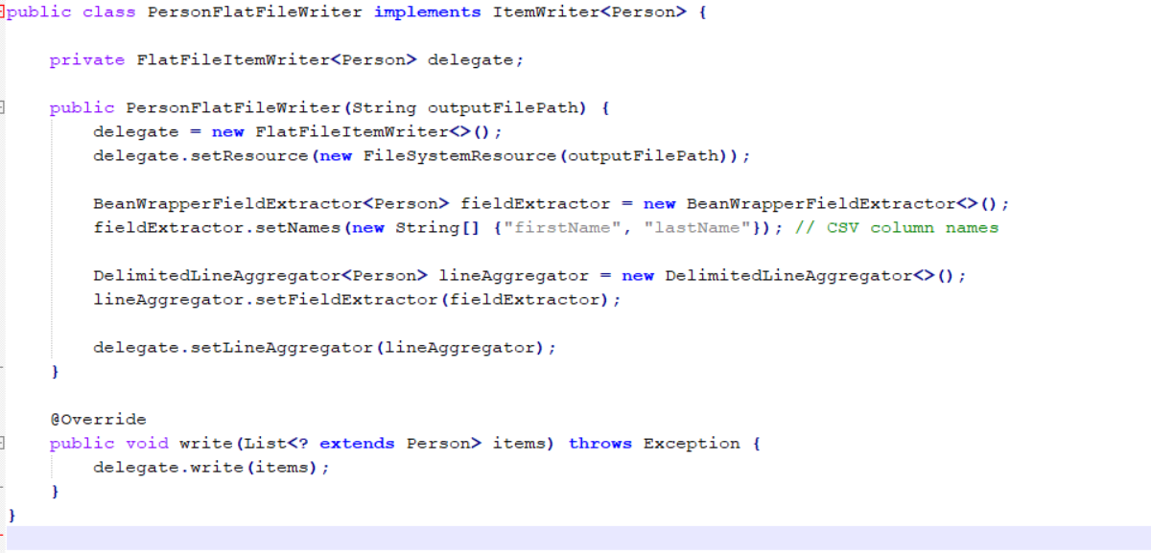
FlatFileItemWriter

Slide 36
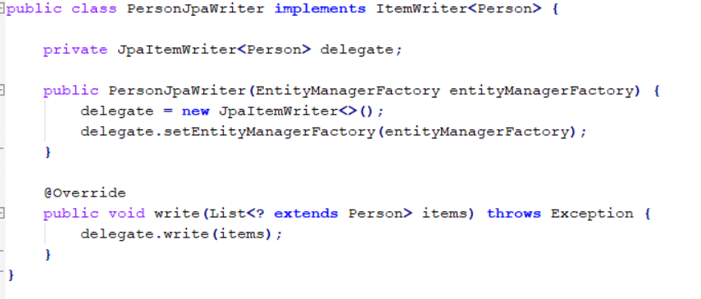
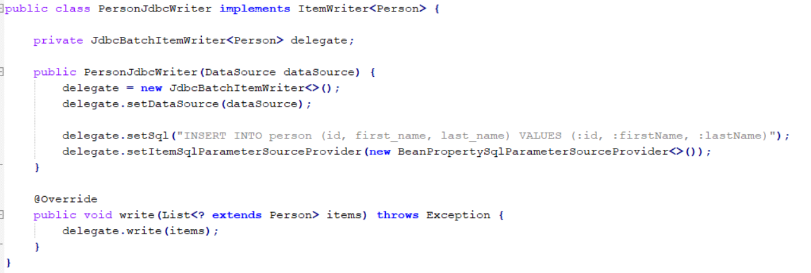
JDBC And JPA ItemWriter

Slide 37
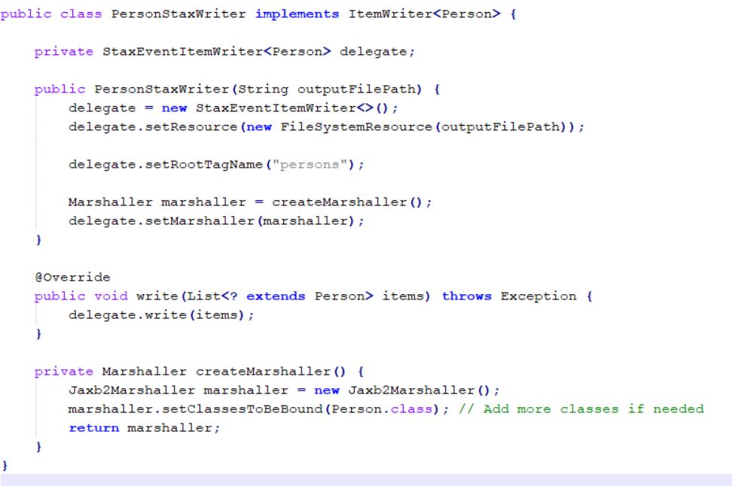
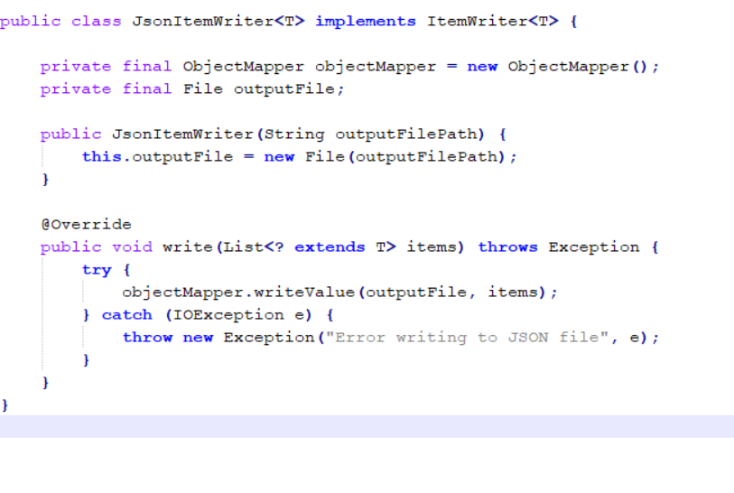
XML And Json ItemWriter

Slide 38
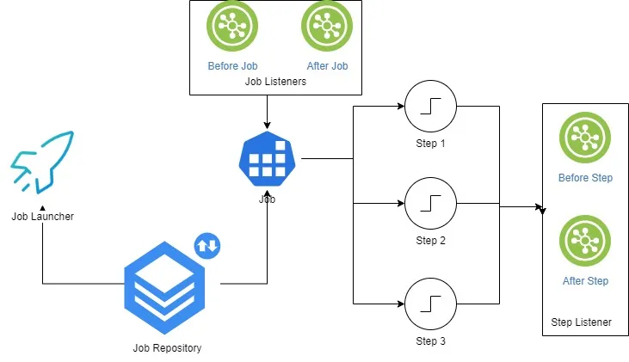
Listeners:
As Spring Batch jobs can run for long times, providing progress information is often critical. For example, which Job is in progress, what all jobs have failed, and what all have been completed. All such information can be gathered using the batch event listeners.

Slide 39
Listener Interface | Annotations | Usage
JobExecutionListener | @BeforeJob @AfterJob | Before the Job has been started After the Job has been completed
StepExecutionListener | @BeforeStep @AfterStep | Before the Step has been started After the Step has been completed
ChunkListener | @BeforeChunk @AfterChunk @AfterChunkError | Before the Chunk has been started After the Chunk has been completed If any error occurred while processing the Chunk
ItemReadListener | @BeforeRead @AfterRead @OnReadError | Before a new Item is read After the Item has been read If any error occurred while reading the Item
ItemProcessListener | @BeforeProcess @AfterProcess @OnProcessError | Before an Item is processed After the Item has been processed If any error occurred while processing the Item
ItemWriteListener | @BeforeWrite @AfterWrite @OnWriteError | Before a new Item is written After the Item has been written If any error occurred while writing the Item
SkipListener | @OnSkipInRead @OnSkipInWrite @OnSkipInProcess | When an Item is skipped due to an error in ItemReader When an Item is skipped due to an error in ItemWriter When an Item is skipped due to an error in ItemProcessor

Slide 40
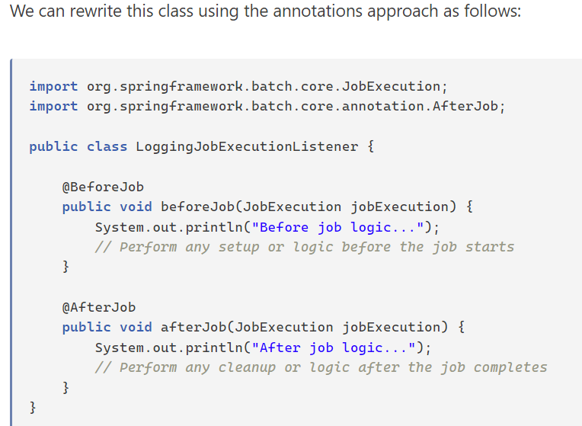
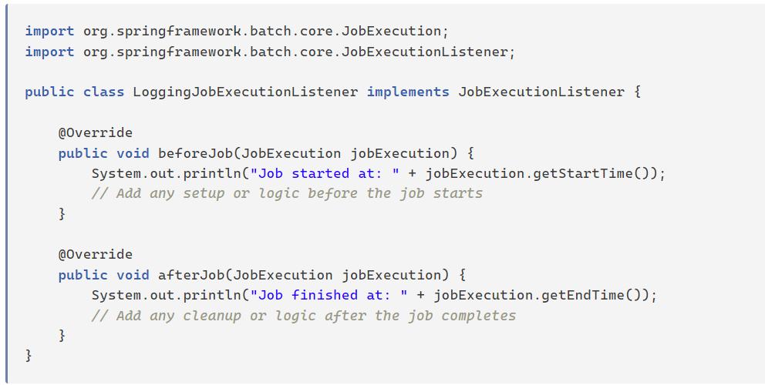
JobExecutionListener:
JobExecutionListener: Handles events related to the entire job, such as before and after job execution.

Slide 41
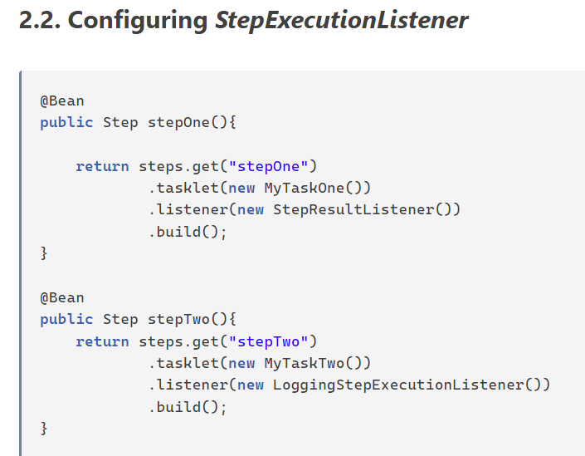
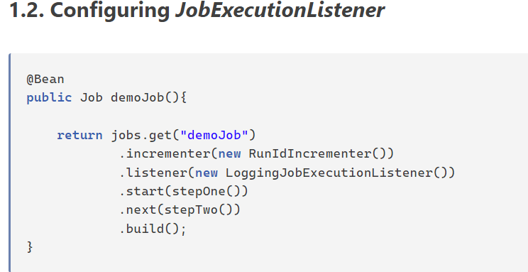
https://howtodoinjava.com/spring-batch/spring-batch-event-listeners/

Slide 42
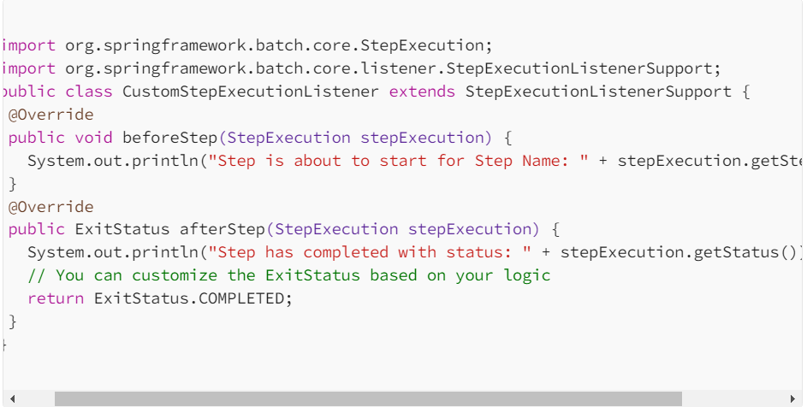
StepExecutionListener:
StepExecutionListener: Manages events specific to individual steps, offering hooks before and after step execution.

Slide 43
References
Spring Batch Tutorial – JavaTechOnline
Guide to Spring Batch Processing | Toptal®
https://www.toptal.com/spring/spring-batch-tutorial
https://docs.spring.io/spring-batch/reference/step/chunk-oriented-processing/intercepting-execution.html
https://alexandreesl.com/tag/jobrepository/

